Slide 1

Fabric CNN Lab Activity
Notes:
To learn on how to build simple CNN architecture for a fabric defect detection, a simple activity has been prepared.

Slide 2
Flowchart
Fabric dataset: 25 defect data & 100 normal data
Normalize the value to [0..1]
Split into training, validation, and testing
1
Load, preprocess, and split the data
Define the layers: convolutional, pooling, & dense
Define the hyperparameters: loss, optimizer, etc
2
Build & compile
the model
Define the epoch, batch_size, validation_split
Train the model
Train the model
3
Predict the class with the help of argmax function
Calculate F1-score of data
4
Calculate F1-score based on argmax class selection
Set threshold to [0..1] with 0.1 increment
Predict the class for each threshold
Calculate F1-score for each threshold
Calculate F1-score in multiple thresholds
5
Select threshold which has the best validation F1-score
6
Show the F1-scores and select the best
Show the F1 results and plots based on
the corresponding threshold from step #6
Compare with argmax the results
7
Notes:
The activity will be divided into 7 simple steps.
First: load, preprocess and split the data
Second: build and compile the CNN model
Third: train the model
Fourth: calculate F1 scores based on argmax class selection
Fifth: calculate F1 score in multiple threshold values
Sixth: show the F1 scores from the fifth step and select the best one
And the last: compare the result with the argmax
In each step, incomplete code will be provided, and you are expected to fill in the blanks and run the code to get certain outputs.

Slide 3

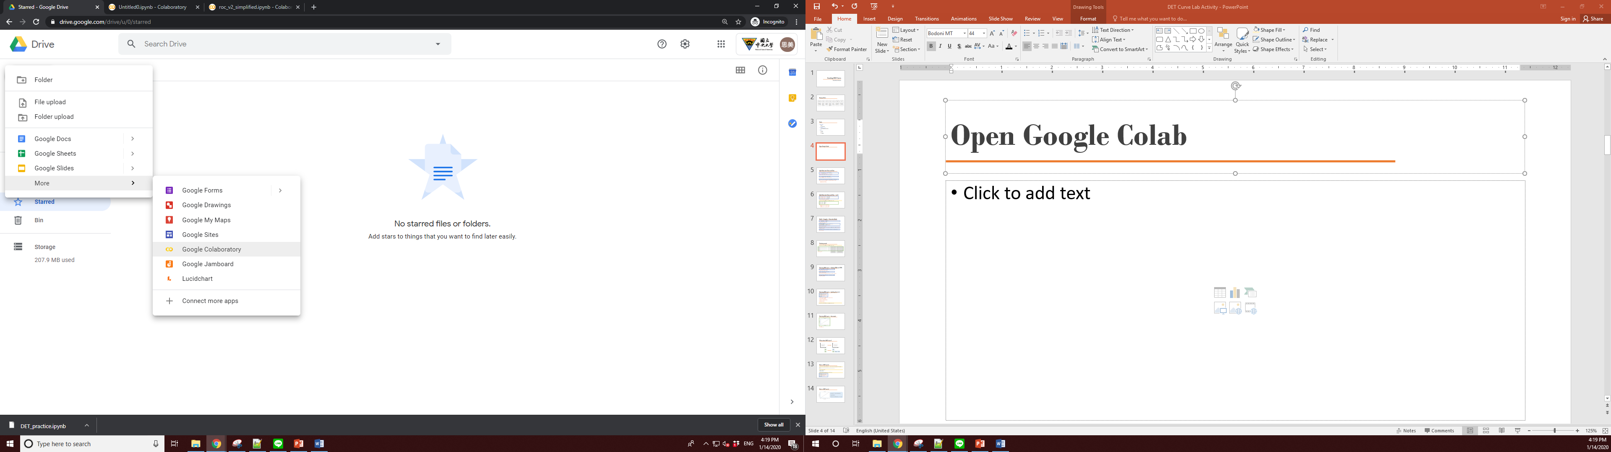
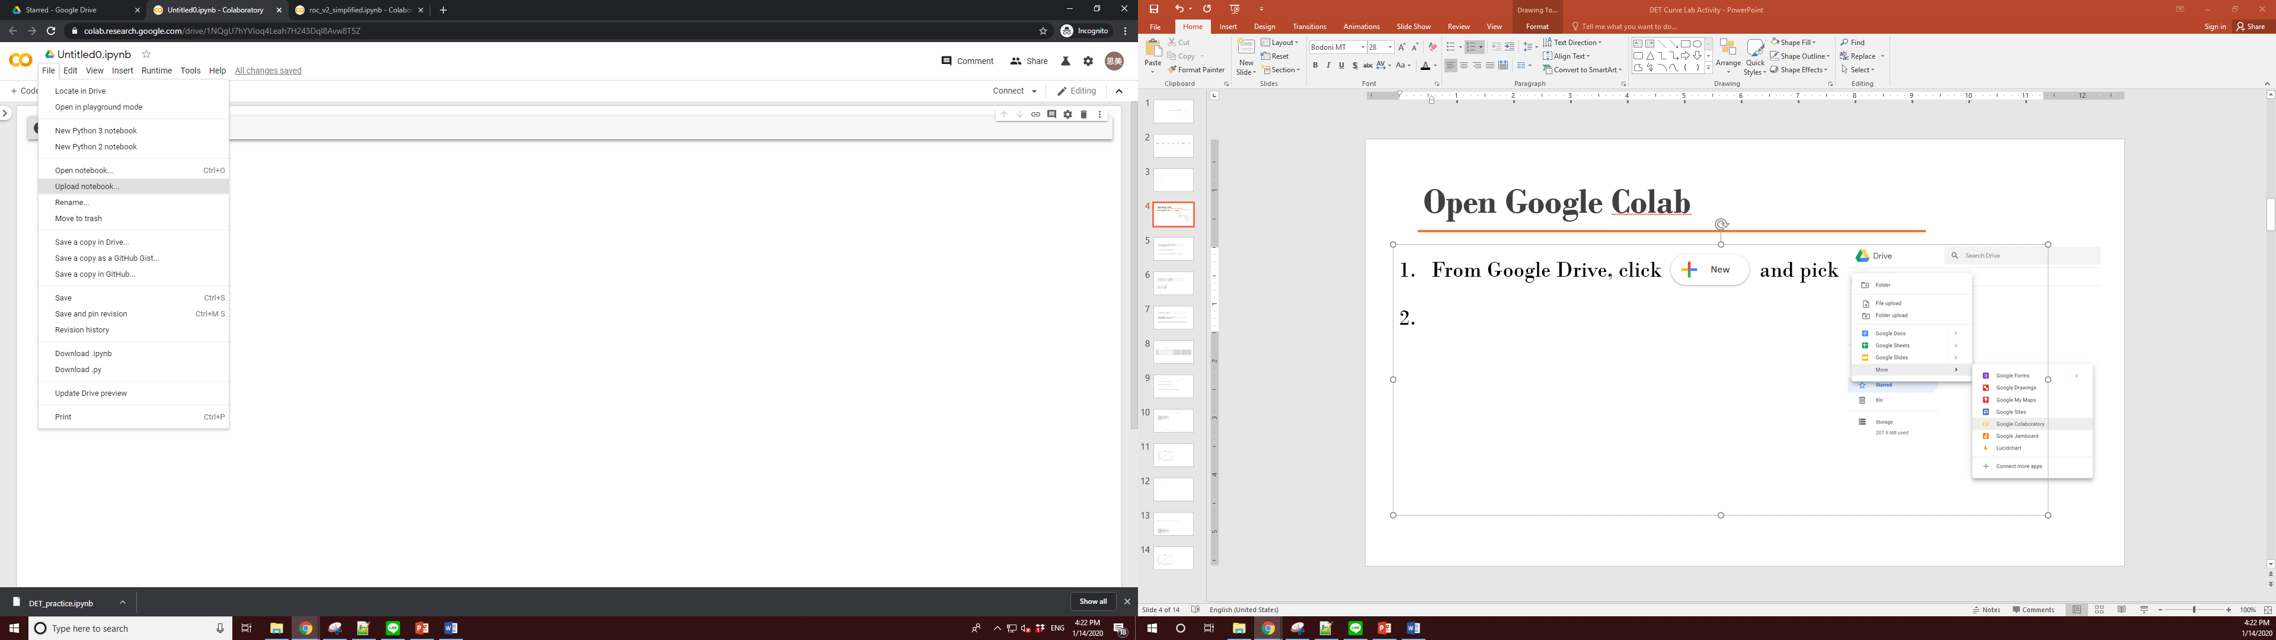
Tools
From Google Drive, click and pick
Click
Choose Fabric_AOI.ipynb file
Notes:
An ipynb file writen in Python and a small fabric dataset has been prepared.
Please download the file and open Google Colab or other Python editor.
If this is your first time writing a code in python, Google Colab is preferable because it is free, and no additional software need to be installed other than your internet browser.
Simply open your Google Drive, click “new”, pick “Google Collaboratory”, click “upload notebook”, and choose our code file “Fabric_AOI.ipynb”

Slide 4
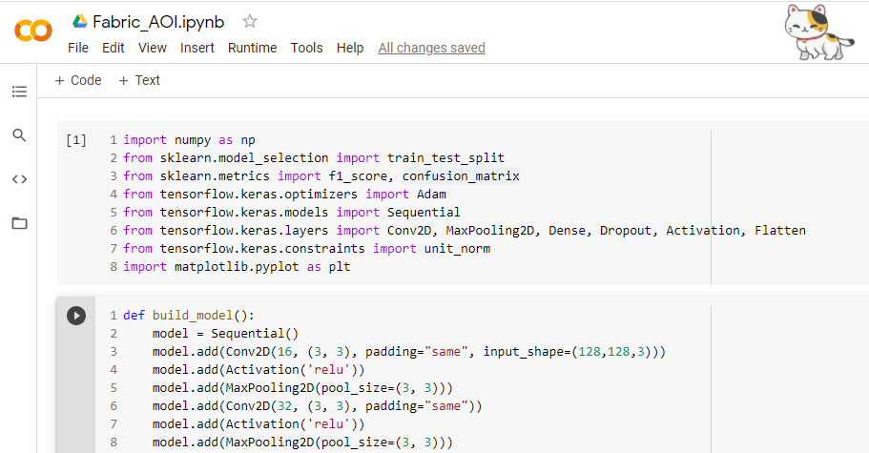
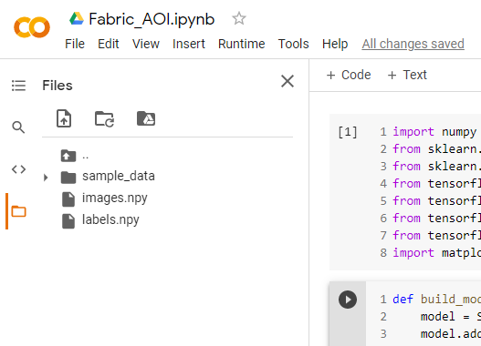
Tools
Click “Files” menu that looks like a folder image at the left hand side of the screen
Drag and drop the .npy files
Notes:
To upload the dataset, click “Files” menu at the left hand side of the screen, then drag and drop the npy files into the file area

Slide 5
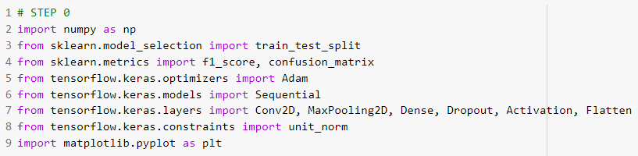
Step 0: import the required functions
Notes:
Import all the required functions by running this cell.
These are the most commonly used libraries to preprocess and build a CNN model.

Slide 6
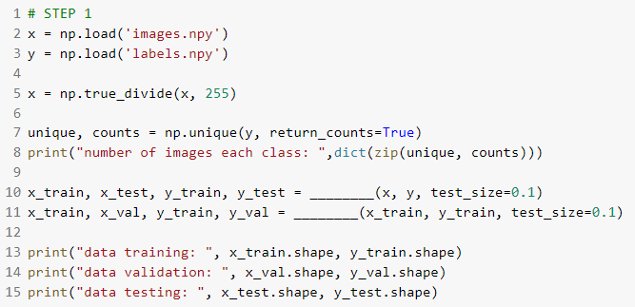
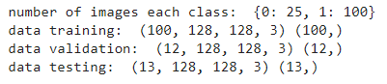
Step 1: load, preprocess, and split the data (please complete the code by filling the blanks)
Load the npy files
Normalize the image files into 0~1
Split into train, validation, and testing
Hint: the function split the data has been imported from sklearn.model_selection
Sample output:
Notes:
Now let’s go through all the steps one by one.
Step 1: Load, preprocess, and split the data.
Line number 2 and 3 shows the data loading process for image and label using numpy function: load
The images are then normalized into 0-1 values by calling the true divide function from numpy in line 5.
To see the number of images in each class, function unique from numpy is called in line 7 and followed by printing the information in line 8.
The data are then split into training, validation, and testing in line 10-11.
To ensure the number of images, the array shape of each subset will be printed in line 13-15.
Please fill in the function name in the blank space and run the code.
If you are not sure which function to call, please see the functions imported from the step 0 in the previous slide.
The output of this cell will match to the image at right hand side of this slide.
As shown in the sample output, out of 125 images, 25 of them belong to class 0, which is defect class, and 100 of them belong to class 1, which is normal class.
In defect detection case, defect class will be labelled as positive, while normal class will be labelled as negative.

Slide 7
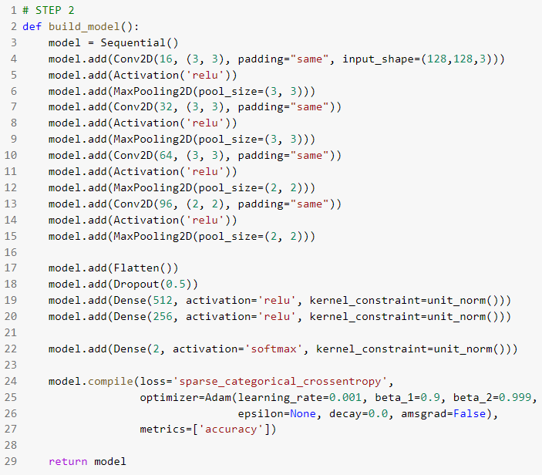
Step 2: build and compile the model
Notes:
Step 2: build and compile the model.
A function has been prepared to build and compile a CNN model with the same architecture as we had in the previous material.
Please run the cell.
There will be no written output of this cell.

Slide 8
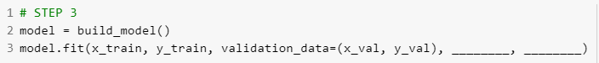
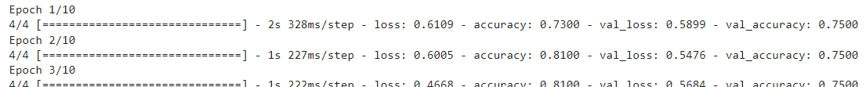
Step 3: train the model (please complete the code by filling the blanks)
Call the function to build the model
Train the model using the training and validation data with epochs 10 and batch_size 32
Sample output:
…
Notes:
Step 3: model training
Using the training and validation data, model training is performed by calling a fit function.
Please complete and run the code by adding epochs 10 and batch size 32 as the hyperparameters.
The output will be losses and accuracies for each epoch during the training process.
Please note that this result might be different from one student to another due to the random data split and random initialization during model training.

Slide 9
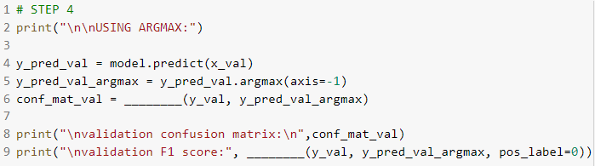
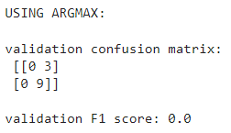
Step 4: Calculate F1-score based on argmax class selection (please complete the code by filling the blanks)
Predict the x data
Select the highest probability class using argmax
Show the confusion matrix & F1 scores
Hint: the function to show the confusion matrix and F1 score have been imported from sklearn.metrics
Sample output:
Notes:
Step 4: F1 score calculation based on argmax class selection.
Line 4 predicts the validation data using the trained model from the previous step.
The prediction returns class probabilities that are then further proceed into class selection by calling argmax function in line 5.
To see the classification result, please call confusion matrix function from sklearn and put it in line 6.
Finally, please call F1 score function from sklearn and print the output in line 9.
Pos label parameter in the function implies that class number 0, which is defect class is considered as positive label instead of class 1.
After the code is complete, please run the cell.
The output of the cell should be the confusion matrix, followed by F1 scores of the validation data.
In our output example, the first row of confusion matrix hints that there are zero defect images that are successfully detected, all 3 of them are predicted as normal,
While the second row of confusion matrix shows that all normal class are successfully predicted as normal.
Since the F1 score does not take any true negative into account, the F1 score returns zero.
Please note that this result might be different from one student to another due to the random data split and random initialization during model training.

Slide 10
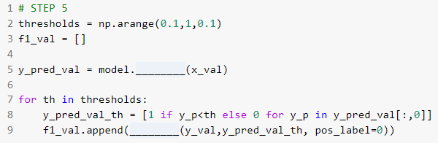
Step 5: Calculate F1-scores in multiple thresholds
Initiate threshold: 0~1 with 0.1 increments
Select the class by comparing it to each threshold
Notes:
Step 5: F1 scores calculation in multiple threshold values.
In this step, we set initial threshold values to 0.1 to 1 with 0.1 increment, as written in line 2.
Then we need to predict the val image with function predict in line 5. Please fill in the blank part of the code.
For each threshold value, the class is selected by comparing the threshold with the defect probabilities in the predicted val data, which is shown in line 8.
The process is followed by F1 score calculation of the class selection result in line 9. Please fill in the blank part of the code.
After the code is complete, please run the cell.
There will be no written output of this cell.

Slide 11
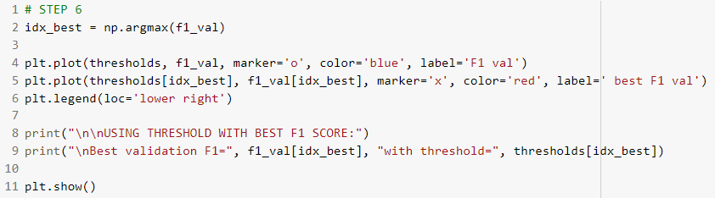
Step 6: Select the best validation F1-score
Select the best F1 scores from all threshold values
Plot F1 scores of the validation data with blue line
Plot the best F1 score of the validation data value with red “X” marker
Notes:
Step 6: best F1 score selection based on the validation data
With the F1 scores stored from the previous step, the index of the best values is saved in idx_best variable as shown in line 2
The corresponding threshold are then selected for the testing phase later.
To visualize the F1 score values for each threshold, and the selected threshold, function plot from matplotlib is called in line 4-6
The value of the best F1 scores, along with the selected threshold are printed in line 8-9.
Please run the cell and observe the output.
Is there any difference with the result from step 4?

Slide 12
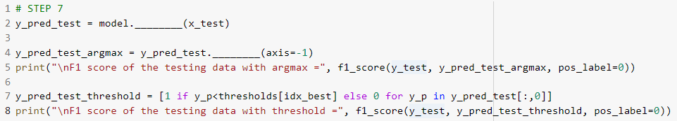
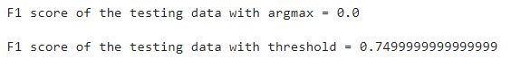
Step 7: Compare the testing results
Predict the testing images
Perform class selection with argmax function
Perform class selection with threshold comparison
Note: your results might be different due to the data shuffling or random initialization
Sample output:
Notes:
To properly compare the results of the argmax vs threshold approach, the prediction has to be performed to the testing data with the selected threshold.
To do so, please complete the code in line 2 to predict the testing image.
The next process is to perform the class selection with argmax function by completing the code in line 4.
The F1 score of this process will be printed in line 5.
The next will be comparing the selected threshold to the probability values in line 7.
The F1 score of this process will be printed in line 8.
After completing the code, please run this cell to get the F1 scores output for both argmax and threshold approach.
The sample output shown in this slide shows that the argmax produced F1 scores of 0 while the threshold approach successfully produce better score with 0.74.
Please note that this result might be different from one student to another due to the random data split and random initialization during model training.

Slide 13
Submission
Please create a report to briefly explain the results
Submit the complete code (data can be excluded) and the report before the specified time
Notes:
Please create a report to briefly explain the activity results.
Attach the code that you wrote and screenshots of the output.
Please submit the report before the specified time.
Thank you for your attention and good luck!

